Slide 1
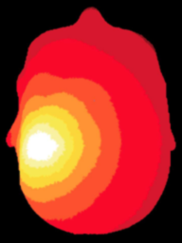
NeuroDOT 2.2.0 Base
Appendix - Visualizations

Slide 2
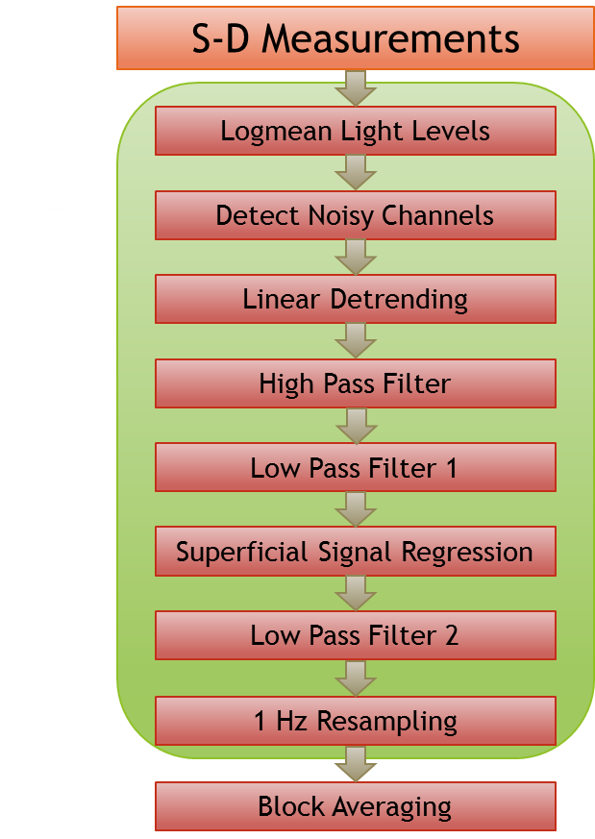
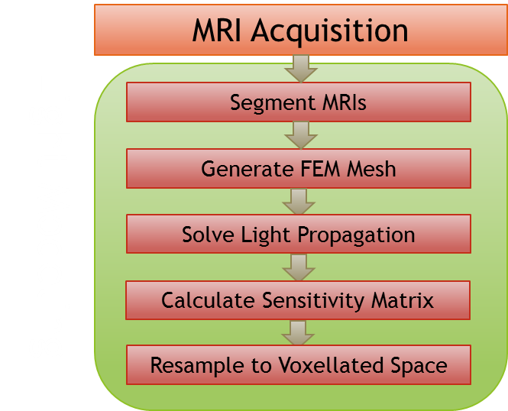
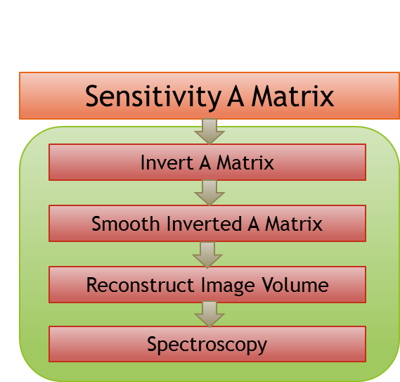
NeuroDOT 2 Overview Flowchart

Slide 3
Preprocessing Pipeline Flowchart
S-D Measurements
Logmean Light Levels
Detect Noisy Channels
Linear Detrending
High Pass Filter
Low Pass Filter 1
Superficial Signal Regression
Low Pass Filter 2
1 Hz Resampling
Block Averaging

Slide 4
Introduction
This appendix is intended to serve as a reference for all visualization functions included in the toolbox.

Slide 5
Generating Data
First, we'll need to run NeuroDOT_Base_DOT_Processing_Script.m, using 'Data/NeuroDOT_Base_HW_Sample_1.mat' as the sample.
This will generate the data from which we create all of the visualizations.
Visualizations will be presented in alphabetical order, with their code prompts in blue, and screenshots to show what the visualizations should look like.

Slide 6
List of Visualizations
PlotCap
PlotCapData
PlotCapGoodMeas
PlotCapMeanLL
PlotFalloffData
PlotFalloffLL
PlotGray
PlotGrayData
PlotHistogramData
PlotHistogramSTD
PlotInterpSurfMesh
PlotLRMeshes
PlotMeshSurface
PlotPowerSpectrumAllMeas
PlotPowerSpectrumData
PlotPowerSpectrumMean
PlotSlices
PlotSlicesTimeTrace
PlotTimeTraceAllMeas
PlotTimeTraceData
PlotTimeTraceMean

Slide 7
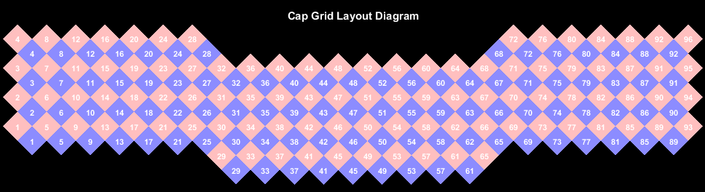
PlotCap
PlotCap(info)

Slide 8
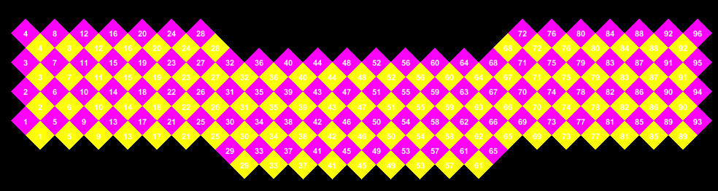
PlotCapData
Ns = numel(unique(info.pairs.Src)); Nd = numel(unique(info.pairs.Det)); SrcRGB = repmat([1, 0, 1], Ns, 1); DetRGB = repmat([1, 1, 0], Nd, 1); PlotCapData(SrcRGB, DetRGB, info)

Slide 9
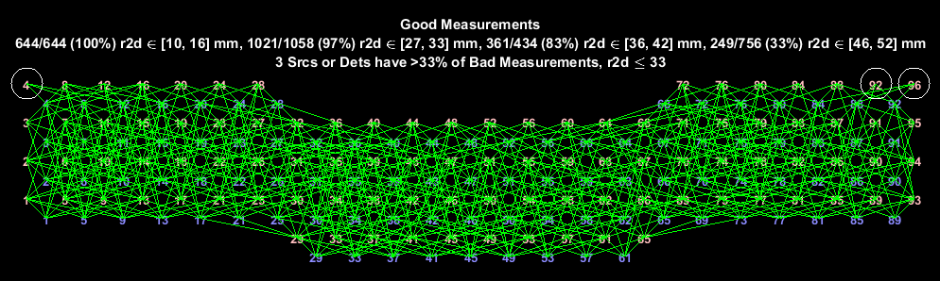
PlotCapGoodMeas
params.rlimits = [10, 16; 27, 33; 36, 42; 46, 52]; PlotCapGoodMeas(info)

Slide 10
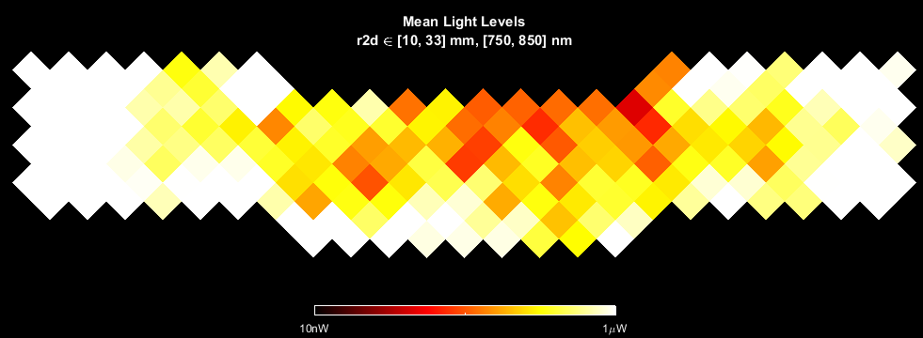
PlotCapMeanLL
params.rlimits = [10, 33]; PlotCapMeanLL(data, info, params)

Slide 11
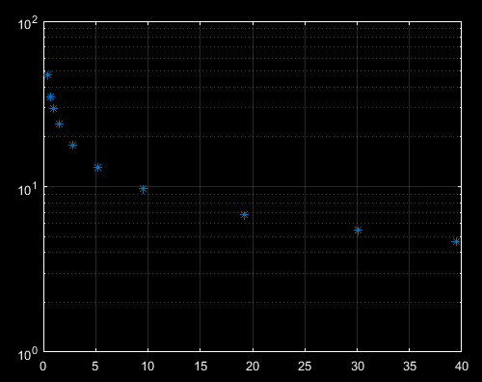
PlotFalloffData
% Mercury, Venus, Earth, Mars, Ceres, Jupiter, Saturn, Uranus, Neptune, Pluto orbital_velocity = [47.36, 35.02, 29.78, 24.01, 17.91, 13.07, 9.68, 6.80, 5.43, 4.67];% In km/s orbital_radius = [.387, .723, 1.000, 1.523, 2.768, 5.204, 9.583, 19.218, 30.110, 39.480];% In AU PlotFalloffData(orbital_velocity', orbital_radius); % Transpose velocity to input as mean levels.

Slide 12
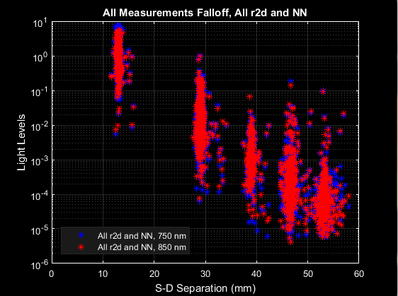
PlotFalloffLL
PlotFalloffLL(data, info)

Slide 13
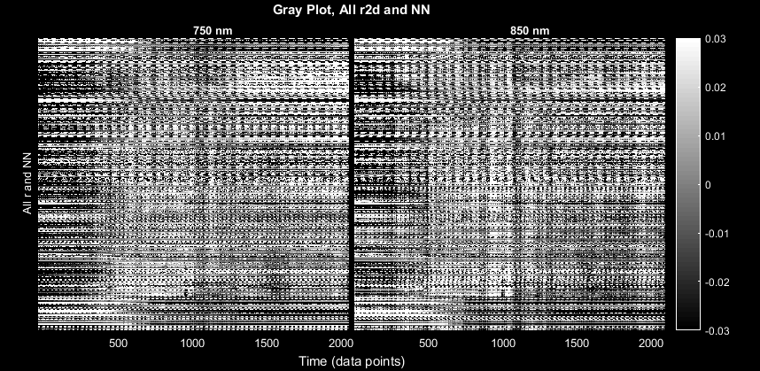
PlotGray
PlotGray(lmdata, info)

Slide 14
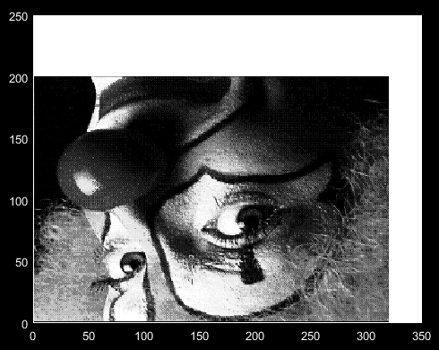
PlotGrayData
load clown PlotGrayData(X')

Slide 15
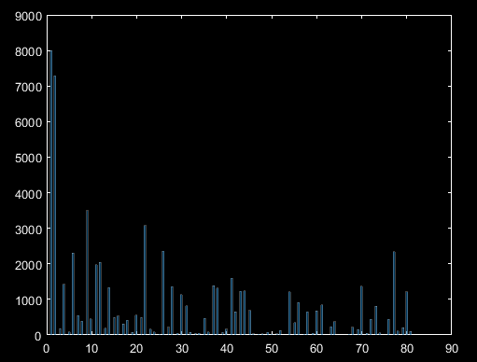
PlotHistogramData
PlotHistogramData(X(:))

Slide 16
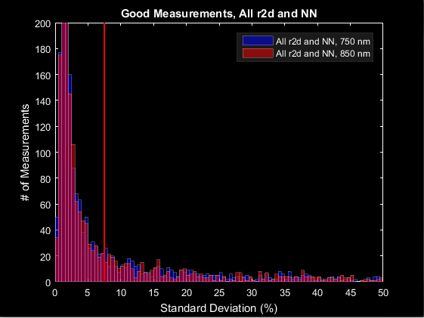
PlotHistogramSTD
PlotHistogramSTD(info)

Slide 17
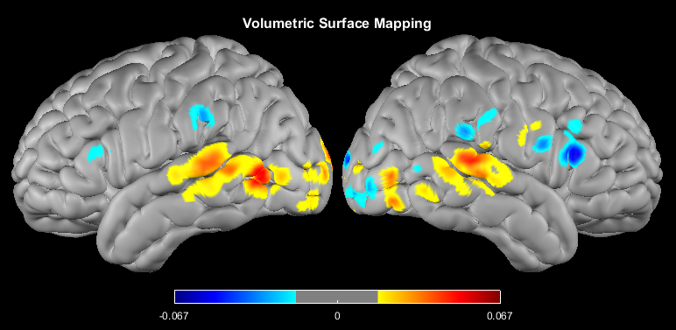
PlotInterpSurfMesh
load('LR_Meshes_MNI_164k.mat') cortex_HbOvol = Good_Vox2vol(cortex_HbO, dim); cortex_HbOvol = normalize2range_tts(cortex_HbOvol, 1:4); t13_21 = mean(cortex_HbOvol(:, :, :, 13:21), 4); PlotInterpSurfMesh(t13_21, MNIl, MNIr, dim)

Slide 18
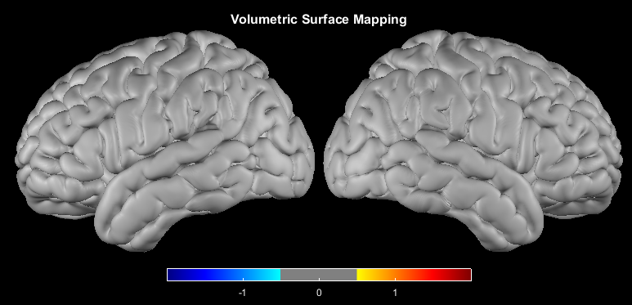
PlotLRMeshes
PlotLRMeshes(MNIl, MNIr)

Slide 19
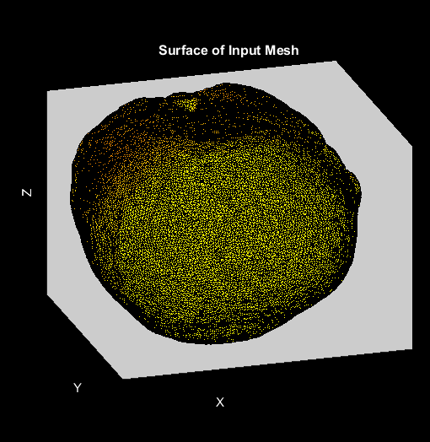
PlotMeshSurface
load('Cap_Fitter_Mesh_Sample.mat') params.Nregs = 1:5; PlotMeshSurface(mesh, infoA, params)

Slide 20
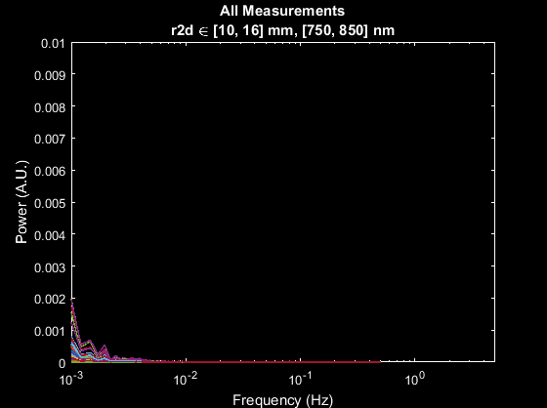
PlotPowerSpectrumAllMeas
params.rlimits = [10, 16]; PlotPowerSpectrumAllMeas(lmdata, info, params)

Slide 21
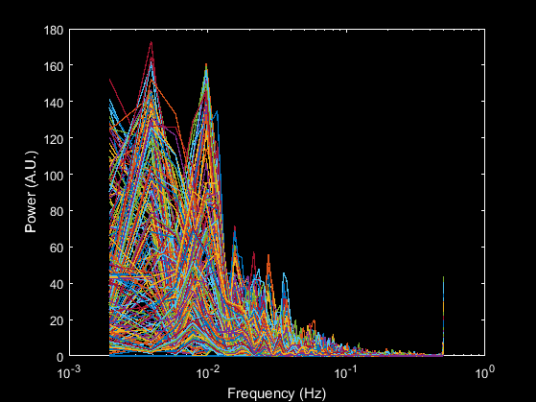
PlotPowerSpectrumData
PlotPowerSpectrumData(X, info)

Slide 22
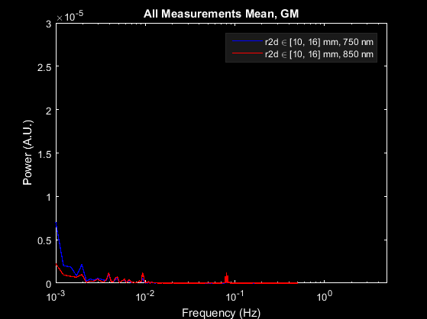
PlotPowerSpectrumMean
PlotPowerSpectrumMean(lmdata, info, params)

Slide 23
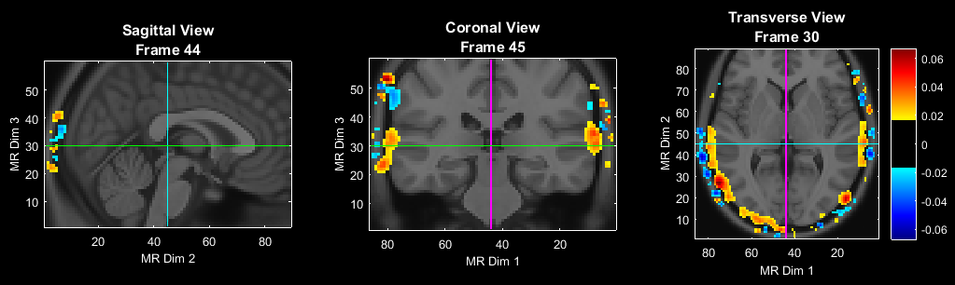
PlotSlices
load('Atlas_MNI152nl_T1_on_111.mat') PlotSlices(atlas, [], [], t13_21)

Slide 24
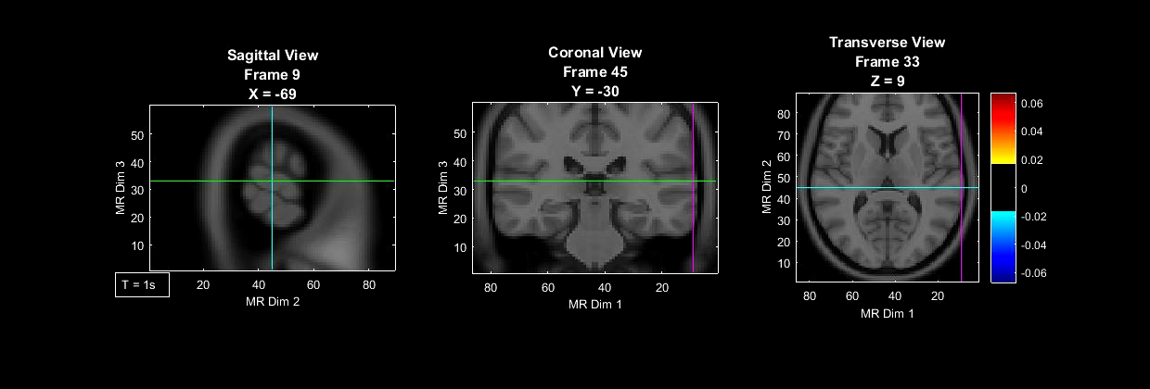
PlotSlicesMov
cortex_HbO = normalize2range_tts(cortex_HbO, 1:4); cortex_HbOvol = Good_Vox2vol(cortex_HbO, dim); avg_size = 9; cortex_HbO_avg = filter(ones(avg_size, 1)/avg_size, 1, cortex_HbO, [], 2); cortex_HbOvol_avg = Good_Vox2vol(cortex_HbO_avg, dim); PlotSlicesMov(atlas, dim, params, cortex_HbOvol_avg, 'test')

Slide 25
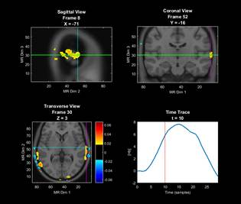
PlotSlicesTimeTrace
PlotSlicesTimeTrace(atlas, dim, params, cortex_HbOvol_avg)

Slide 26
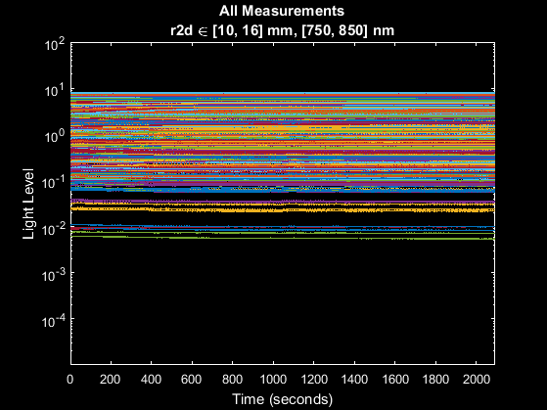
PlotTimeTraceAllMeas
PlotTimeTraceAllMeas(data, info, params)

Slide 27
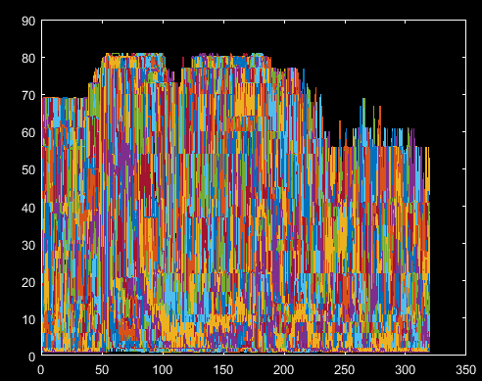
PlotTimeTraceData
PlotTimeTraceData(X, 1:size(X,2))

Slide 28
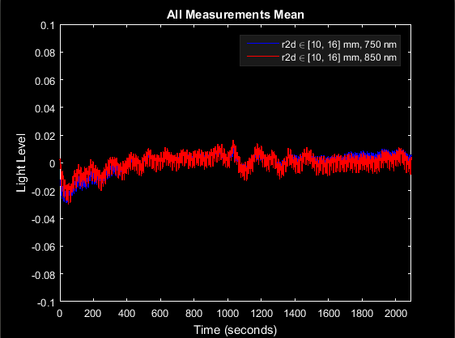
PlotTimeTraceMean
PlotTimeTraceMean(lmdata, info, params)

Slide 29
That’s It (Again)
Congratulations! You have finished the NeuroDOT 2 Base Preprocessing Pipeline Analysis Appendix.
For further questions or more information, please consult the NeuroDOT 2 Base User Manual and the various Appendices.
NeuroDOT 2 Team:
Adam Eggebrecht (aeggebre@wustl.edu)
David Muccigrosso (muccigrosso.david@wustl.edu)

